Slide 1


C Mini Project Presentation on
“Encryption And Decryption Of Files”
Student: Ankith GB
Adithya J Shetty
Guide:
Department of Computer Science and Engineering
RNS Institute of Technology
2022-23

Slide 2
CONTENTS
INTRODUCTION
PROBLEM STATEMENT
FLOW CHART
ALGORITHM
RESULTS

Slide 3
INTRODUCTION
This is a C program for file encryption and decryption using a simple bitwise XOR operation with a key. The program takes user input to either encrypt or decrypt a given file. The user also provides the input file name and output file name for the operation. The program reads the input file, performs the encryption or decryption operation using a predefined key, and writes the output to the specified output file. The program then displays a message indicating whether the operation was successful or not. It is a simple implementation of file encryption and decryption using basic C file handling and bitwise operations.

Slide 4
PROBLEM STATEMENT
Create a program in C that can encrypt and decrypt a file using a simple XOR encryption method. The program should take user input for the file names and offer two options: to encrypt or to decrypt the file.

Slide 5
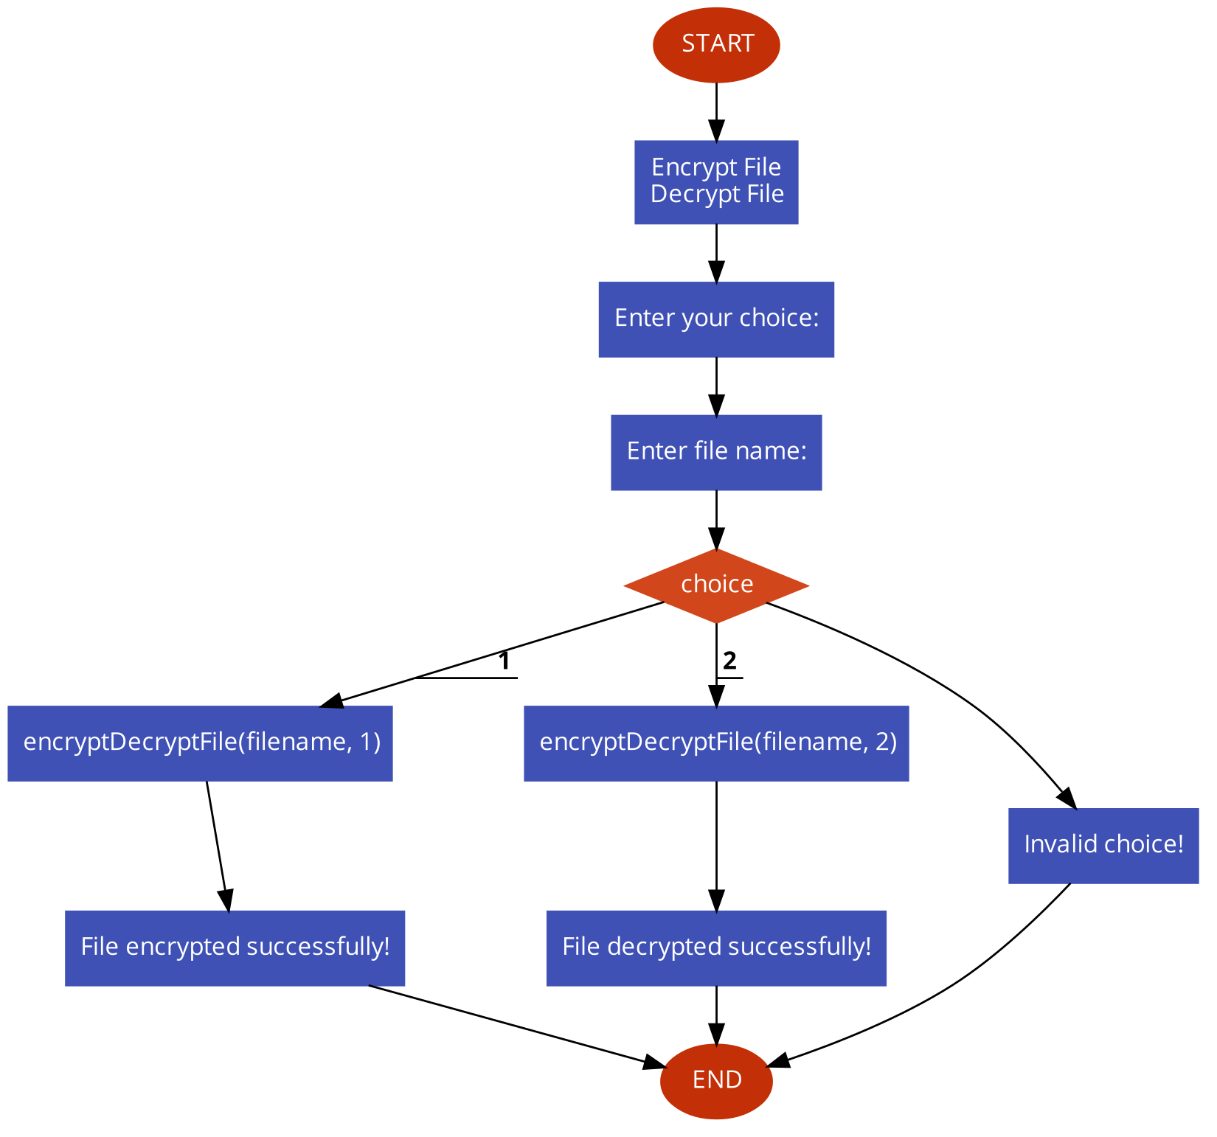
FLOWCHART

Slide 6
ALGORITHM
START.
Display a menu to the user with options to encrypt or decrypt a file
Ask the user to input the filename of the file to be encrypted or decrypted
Ask the user to input the filename of the output file
Open the input file in binary mode and check if it was successfully opened
Open the output file in binary mode and check if it was successfully opened
If the user selected encryption, read the input file byte by byte, perform a bitwise XOR operation with a predefined key, and write the result to the output file
If the user selected decryption, read the input file byte by byte, perform the same bitwise XOR operation with the same key, and write the result to the output file
Close both the input and output files
Display a message indicating whether the operation was successful or not
END.

Slide 7
RESULTS
1. Encrypt File
2. Decrypt File
Enter your choice: 1
Enter file name: yes.txt
File encrypted successfully!
Result: ./5f/5f'f2#>2f /*#h
1. Encrypt File
2. Decrypt File
Enter your choice: 2
Enter file name: yes.txt
File decrypted successfully!
Result: This is a text file.

